Slide 1
Connectivity Analytics

Slide 2
Connectivity
we will explore another fundamental property of graphs called Connectivity.
We list two important kinds of graph analytic questions that are based on connectivity.
The first case is about the robustness of the network.
Suppose we have a computer network with many servers and a hacker is trying to bring the system down, you set a small set of servers that the hacker can target to disrupt the network.
What we mean by disrupt is to disconnect a part of the network from the rest.

Slide 3
Connectivity
A similar problem may occur in the power distribution network.
In that case, an attacker may be able to attack one or two central components so that large portions of the network loses power.
Many biological networks have built in redundancy, so that even if you disrupt one important gene, there are other genes in the network which will support the biological function, possibly through other routes.
Therefore a network is robust, if removing one or more edges or nodes still keeps it connected.

Slide 4
Connectivity
The second category is about network comparison in terms of their overall connectivity.
The two graphs shown here are very different in their structure.
What are some parameters by which we can compare them?
we must first define the concept of connectivity. Very simple.

Slide 5
Connectivity
A graph is connected if we can reach any node from any other node.
Let's look at the crypto graph in the picture, clearly we cannot reach from all nodes to all nodes here because this graph is not connected.
However, we can identify four parts of the graph that are themselves connected.
These islands of connected parts are called components or connected components of a graph. For directed graphs, we need to be a little more specific about connectivity.

Slide 6
Connectivity
For directed graphs, we need to be a little more specific about connectivity.
We say that the directed graph is strongly connected, if we follow the direction of the edges and still reach every node from every other node.
A weaker form of connectivity is if we do not care about the direction of the arrows and can reach every node from every other node.
Another way of saying it is that the undirected version of the graph is connected, this is called Weak Connected.

Slide 7
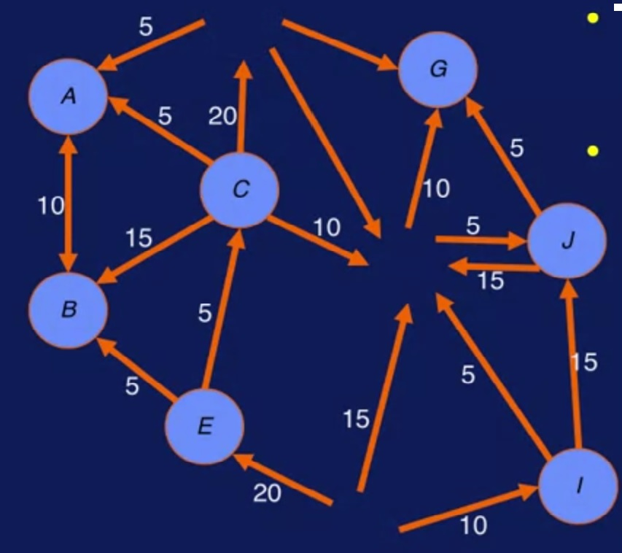
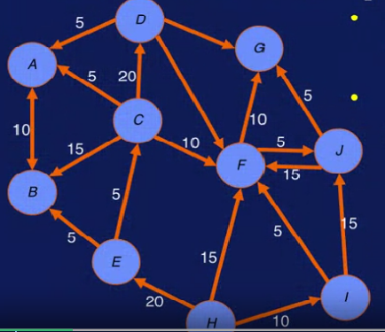
Vertex Connectivity
There are two ways to break a graph.
Identifying the smallest node set which if removed will disconnect the graph.
Here, if we remove F, D and H or H, F, G, we have disconnected the graph.
So the separating set is either H,F and G, or H, F and D.
So the connectivity is three.

Slide 8
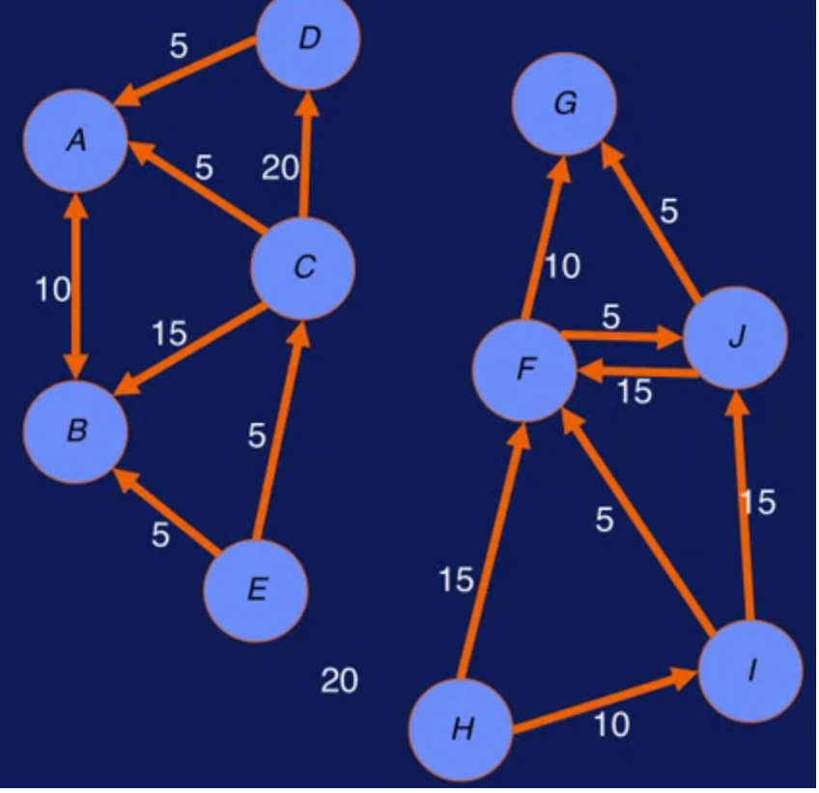
Edge Connectivity
Similarly, removing C-F, D-G, D-F and H-E edges will also disconnect the graph.
Therefore, the edge connectivity is four.
So this is how network robustness is defined.

Slide 9
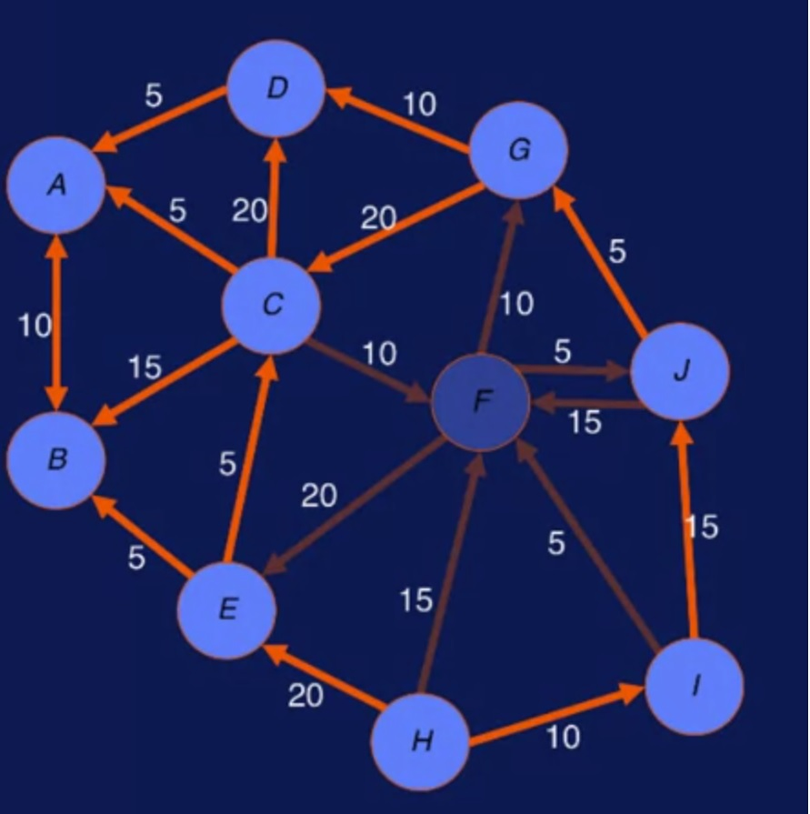
Connectivity
Let's check, if this network robust?
Suppose the attacker removed node F. Why remove F? Because F is the most connected node. That is, F has the highest degree. If we remove F, five paths are disrupted.
For example, there is no way to go from C to G, or from I to E, because these paths went through F. Let's try this exercise.
Paths C–G, C–J, C-E, J-E and I-E gets disrupted

Slide 10
Connectivity
Suppose the attacker has already removed F.
And would like to cause more damage to the rest of the network.
Which node should be targeted next?
The answer is C, because C is the next most connected node.
Higher degree nodes makes the network more vulnerable.

Slide 11
Degree of the node
We define the degree of the node as the number of edges connected to it. Thus specifying if a node is more connected than another.
Looking closer we can separate out that two components denotes degrees into in degree and out. Which are the counts of the incident and the outgoing edges of a node respectively.

Slide 12
Degree of the node
We first construct this degree table for each node.
It's a simple procedure where we count the number of nodes with degree. 0, 1, 2, and so forth. The degree versus count table is a degree histogram of the graph.
We can compare two graphs by computing the vector distance between them. One simplistic measure is just the Euclidean distance.
For our case, the degree histogram based on comparisons of the histograms find the graphs to be very similar.

Slide 13
Degree of the node
The nodes with more incident edges than outgoing edges represent entities that take in more than they put out. In a social networking setting, they represent members who are listeners. They receive a lot of posts, but send much fewer posts.
On the opposite side of the spectrum, there are talkers whose out-degrees exceed their in-degrees.
The entities that are in between, that have both large values of in-degree and out-degree. These are communicators.

